Slide 1
Stationary Air Emission Source Database
Andrew Toussaint

Slide 2

Background
Track stationary sources that emit harmful pollutants
Each source may be in charge of multiple units
Emission limits for each unit are determined by federal regulations

Slide 3
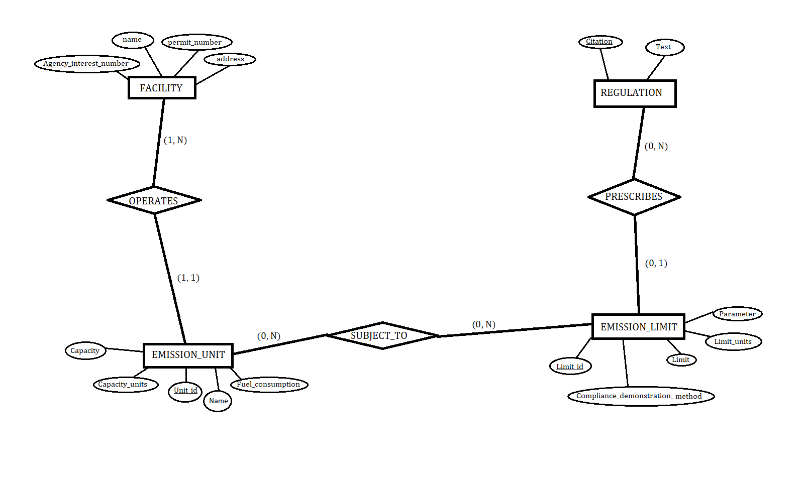

Slide 4
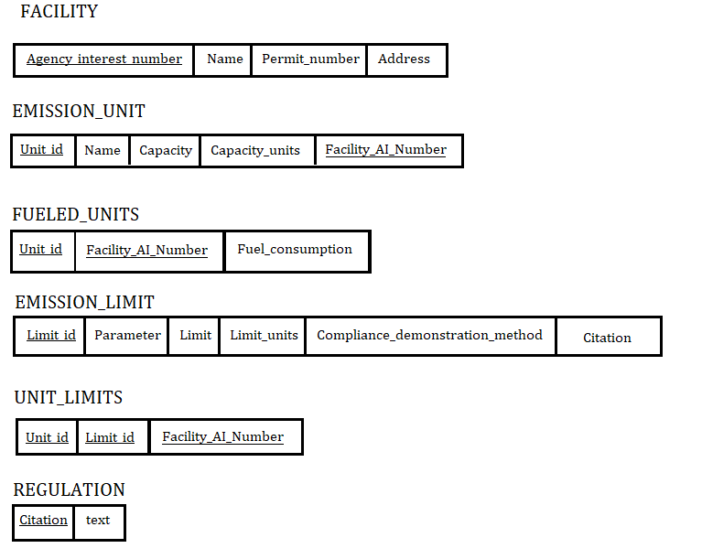

Slide 5
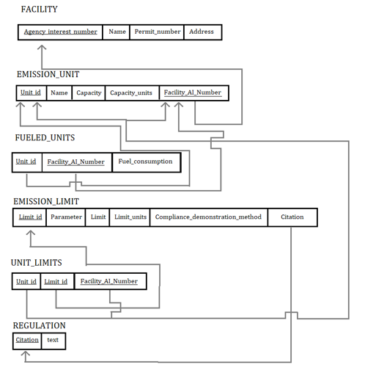

Slide 6
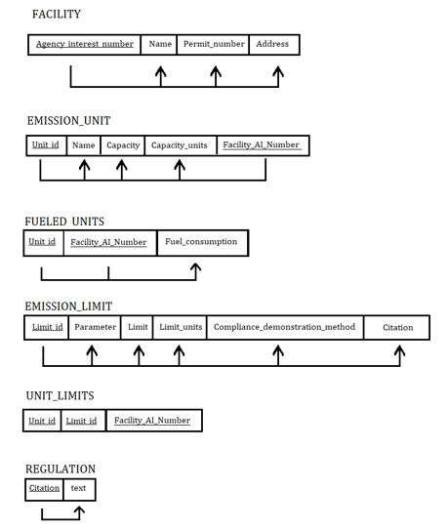

Slide 7
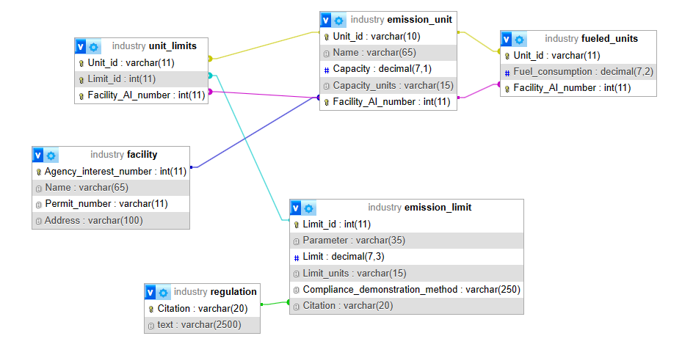

Slide 8


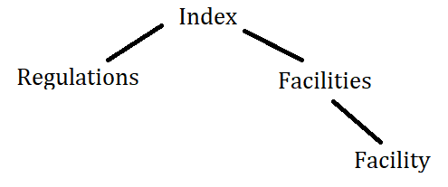

Web Application

Slide 9
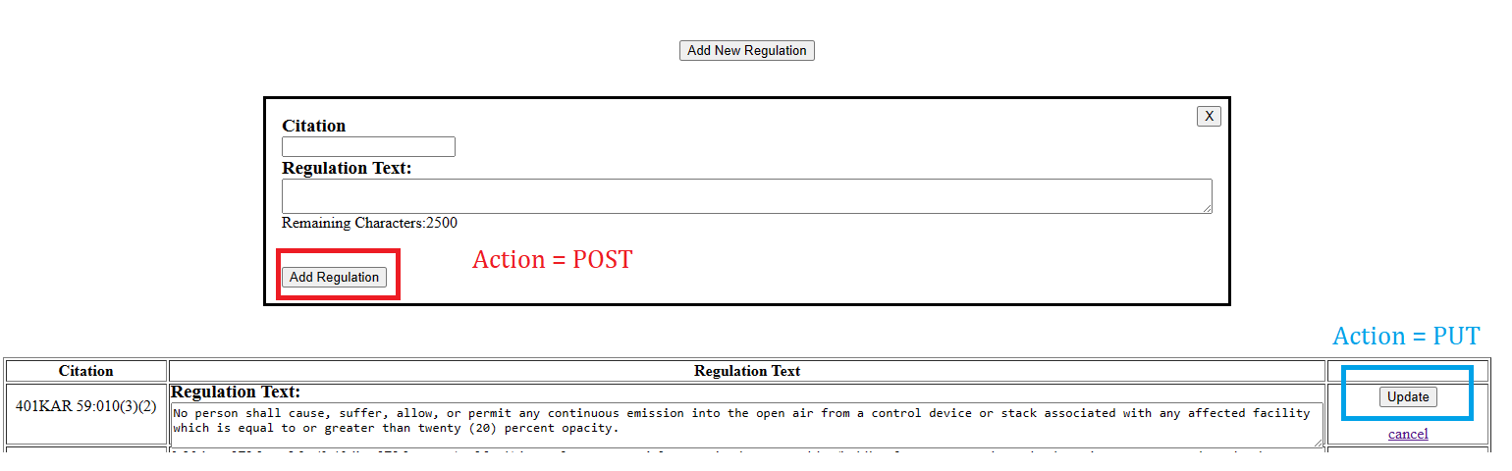
Web Page Design

Slide 10
Bugs, challenges, and Limitations
Sanitizing user inputs
Managing multiple copies of the same form on a page
Post – Redirect – Get
Preventing adding duplicate primary keys

Slide 11
References
PHP: PHP Manual - Manual
jQuery API Documentation
Elmasri, R., & Navathe, S. (2016). Fundamentals of Database Systems (7th ed.). Pearson.
eSearch (ky.gov)
ajtoussaint/CS443G_FinalProject (github.com)

